Slide 1
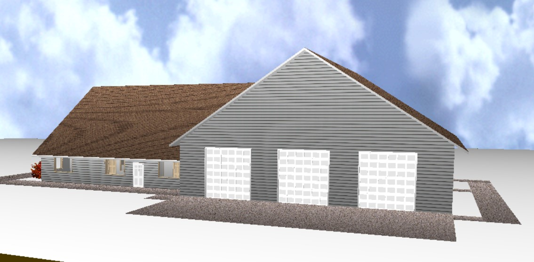
East Side Fire District
Fire - EMS - Rescue

